Slide 1


Dr. D. Y. Patil Pratishthan's Institute for Advanced Computing and Software Development
DAY 8 C Programming

Slide 2
Why Structures?
Array is a data structure containing elements of same type.
In real world applications,one needs to store data of different types.
Diffculty
More than one array is required.
Handling arrays becomes difficult with increase in the amount of data.
E.g:- to store information about a customer,customer_id,name,account balance etc…

Slide 3
What is a Structure?
User defined data type.
Convenient way of grouping of members of different types.
May contain any number of members of different types.
Can form the basis for more complex constructions ,such as linked lists.
It may contain any number of members of different types.

Slide 4
Syntax of Structure:-
struct structure_name
{
data_type member1;
data_type member2;
.
.
data_type memeberN;
};
Example:-
struct customer
{
char custName[20];
int custId;
Float amt;
char address[25];
char phone[10];
};

Slide 5
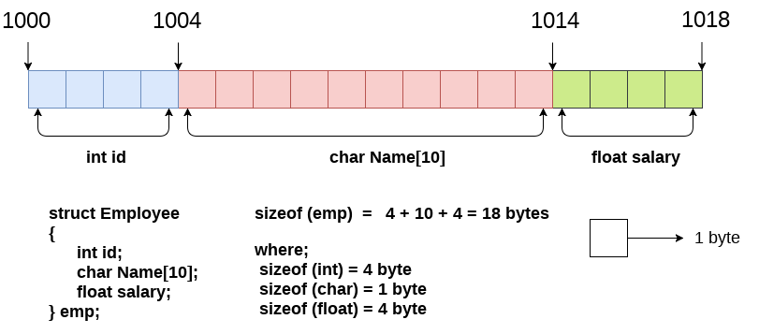
Memory Allocation
struct employee
{ int id;
char name[20];
float salary;
};

Slide 6
Structure Variables
The members of structure can be processed individually
Structure variables can be initialized when declared
struct savAcc
{
int custId;
char custName[20];
float balAmt;
}
struct savAcc ac1,ac2;
struct savAcc ac3={1005,”smita”,6000};
Structure variable can also be defined
struct savAcc{
Char custName[20],int custId;
float balAmt;}ac1;

Slide 7
typedef
The typedef is a keyword used in C programming to provide some meaningful names to the already existing variable in the C program
. It behaves similarly as we define the alias for the commands. In short, we can say that this keyword is used to redefine the name of an already existing variable.
Syntax of typedef
typedef <existing_name> <alias_name>
typedef int tool;
tool x,y;

Slide 8
Using typedef with structures
Consider the below structure declaration:
struct student
{
char name[20];
int age;
};
In the above structure declaration, we have created the variable of student type by writing the following statement:
struct student s1;
The above statement shows the creation of a variable, i.e., s1, but the statement is quite big. To avoid such a big statement, we use the typedef keyword to create the variable of type student.

Slide 9
Example of typedef
struct student
{
char name[20];
int age;
};
typedef struct student stud;
stud s1, s2;
typedef struct student
{
char name[20];
int age;
} stud;
stud s1,s2;

